Slide 1
K-Means Clustering Baltimore City Crime Data
By: Shayan Darian, Jake Watson, Yamato Eguchi

Slide 2
The Problem & Our Motivation
Given coordinates of crimes in the city of Baltimore from 2011-2016, analyze where crimes are concentrated using K-Means Clustering.
If the crimes are centralized in certain areas, it may help the police identify areas needing more support in order to improve response times
The data we used was publicly available via the Baltimore Police Department
https://data.world/data-society/city-of-baltimore-crime-data

Slide 3
Programming Languages – Python and C++
Python
Pandas and Matplotlib to find the optimal number of clusters using the elbow method and to derive a graphical representation of the output cluster results
C++
CUDA to parallelize computation of finding the minimum distance from point to centroid and to calculate sum of cluster points

Slide 4
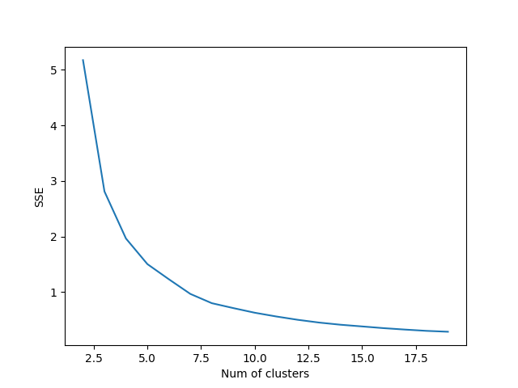
Plots – Elbow Method

Slide 5
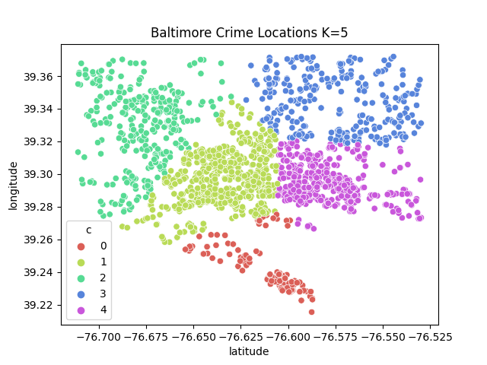
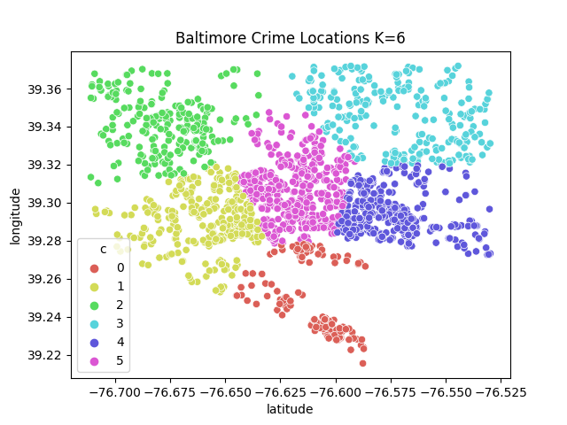
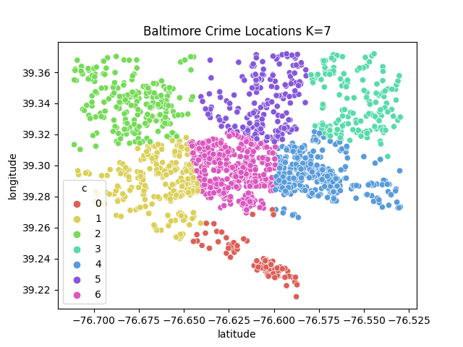
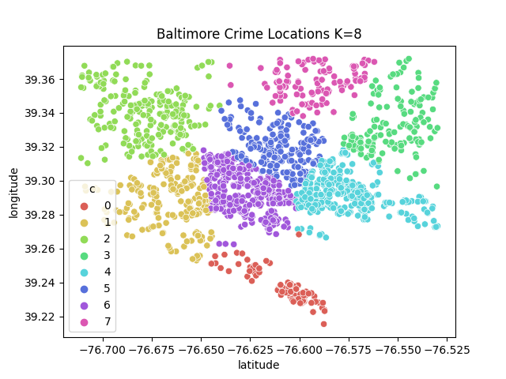
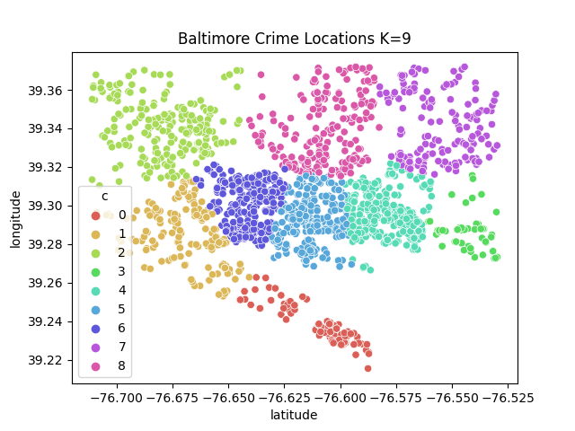
Plots – Kmeans Clusters

Slide 6

Plots – Kmeans Clusters

Slide 7
Algorithm
Allocate memory for the data, list of centroids, and sums of clusters
Initialize the centroids by randomly selecting an x,y coordinate pair from the data
For each coordinate in the data, calculate the minimum distance to centroids and assign the coordinate to the cluster with the minimum distance
Compute the cluster sums in parallel
Compute the new centroids using the cluster sums and number of coordinates in the cluster
Check for convergence ? break loop : continue with next iteration;

Slide 8
Demo / Code
struct Point {
// MEMBER VARIABLES:
// x: latitude
// y: longitude
// minDist: minimum distance from point to cluster
// clusterID: cluster ID that this point belongs to
double x;
double y;
double minDist;
int clusterID;
// CONSTRUCTORS
Point() : x(0), y(0), minDist(DBL_MAX), clusterID(-1) {};
Point(const double x, const double y) : x(x), y(y), minDist(DBL_MAX), clusterID(-1) {};
};

Slide 9
Demo / Code
struct Centroid {
// MEMBER VARIABLES:
// x: latitude
// y: longitude
// id: cluster's ID
// nPoints: number of datapoints in cluster
double x;
double y;
int id;
int nPoints;
// CONSTRUCTORS
Centroid() : x(0), y(0), id(-1), nPoints(0) {};
Centroid(const double x, const double y) : x(x), y(y), id(-1), nPoints(0) {};
};

Slide 10
Demo / Code
__global__ void calculate_min_distance(Point * datapoints, Centroid * centroids, int clusterID){
int index = threadIdx.x + blockIdx.x * MAX_THREADS_PER_BLOCK;
if (index < DATA_LENGTH) {
double x_sqr = pow((datapoints[index].x - centroids[clusterID].x), 2.0);
double y_sqr = pow((datapoints[index].y - centroids[clusterID].y), 2.0);
double distance = x_sqr + y_sqr;
if (distance < datapoints[index].minDist) {
datapoints[index].minDist = distance;
datapoints[index].clusterID = clusterID;
}
}
}

Slide 11
Demo / Code
__global__ void compute_cluster_sums(Point * datapoints, Centroid * centroids, double * xsums, double * ysums) {
int index = threadIdx.x + blockIdx.x * MAX_THREADS_PER_BLOCK;
if (index < DATA_LENGTH) {
int clusterID = datapoints[index].clusterID;
atomicAdd(&centroids[clusterID].nPoints, 1);
atomicAdd(&xsums[clusterID], datapoints[index].x);
atomicAdd(&ysums[clusterID], datapoints[index].y);
// reset min distance
datapoints[index].minDist = DBL_MAX;
}
}

Slide 12
Technical Difficulties
Race condition and hardware limitations:
When computing sums of cluster points in parallel, we came across a race condition where the sum would be overwritten by threads
To solve this issue, we used atomicAdd(double *, double).
Note: It was necessary for us to overload the function because the NVIDIA GPU did not natively support atomic `double` additions

Slide 13
Difficulties We Were Unable to Solve
Outlier data affected our clustering
We ultimately decided to omit these datapoints to achieve higher quality clustering, as these points were about 50x farther away from the majority of the data
Only 5 out of 1986 data points were removed

Slide 14
Shortcomings
Naïve centroid assignment:
For simplicity, we naively assigned the initial centroid state as a randomly selected coordinate from our data
To achieve higher quality of clustering, we would like to implement better initial centroid assignment using the methods discussed in class.

